Slide 1
CSS Grid Layout: Modern Web Design Made Easy
This professional guide simplifies CSS Crid for two-dimensional layouts. It covers essential concepts for modern web design. You will learn to create flexible and responsive interfaces.
- By Dhanraj Hemant Kale

Slide 2
What Is CSS Grid?
Two-Dimensional Power
CSS Crid is a layout system. It handles both rows and columns. This allows for precise control over placement.
Broad Browser Support
All major browsers support CSS Crid. Support began in 2017. This ensures wide compatibility.

Slide 3
Why Use CSS Grid?
Simplifies Complex Layouts
It eliminates floats or positioning. Create intricate designs easily.
Responsive by Design
Achieve fluid layouts effortlessly. Fewer media queries are needed.
Enhanced Control
Manage content flow precisely. Improve overall design integrity.

Slide 4
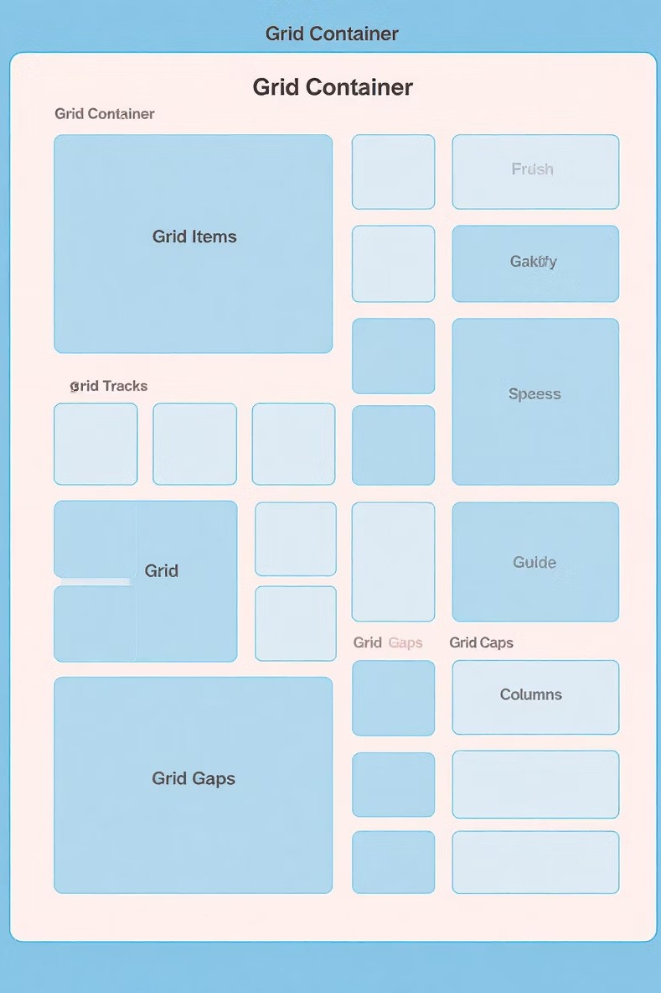
Key Terminology: Grids, Tracks, Gaps
Grid Container & Items
The container is the parent element. Items are direct children. This establishes their relationship.
Tracks: Rows & Columns
Tracks define layout structure. They use template properties. This sets explicit dimensions.
Gaps: Spacing
Caps control space between cells. The gap property defines them. This creates visual separation.

Slide 5



Creating Your First CSS Grid
Set Display Grid
Apply display: grid to the container. This initializes the grid context.
Define Columns
Use grid-template-columns property. Specify column widths. Example: 200px 200px 200px.
Add Rows
Utilize grid-template-rows. Define explicit row heights. This completes the grid structure.

Slide 6
Core Properties and Patterns
Named Layout Zones
grid-template-areas creates named zones. This simplifies complex layouts. Assign areas with ease.
Item Placement
grid-column and grid-row position items. Place elements precisely. Control spanning behavior.
Layout Control
gap, align-items, justify-items manage spacing. Control alignment within cells. Fine-tune visual presentation.

Slide 7
Advanced Techniques & Real-World Examples
Responsive Units
Use fr units for flexible sizing. Combine with minmax() for adaptability.
1
Item Overlapping
Overlap grid items. Create unique visual compositions. Achieve dynamic design effects.
2
Complex Layouts
Build intricate dashboards or galleries. Ensure responsiveness. Deliver professional interfaces.
3

Slide 8
Best Practices and Resources
Define grid early in your design process. This ensures maximum flexibility and structure.
Combine CSS Crid with Flexbox for nuanced UI components. Flexbox handles content within cells well.
Explore official documentation and tutorials: MDN, CSS-Tricks, W3Schools are excellent. Practice with interactive games like Crid Carden to solidify understanding.

